Slide 1
COD Ch. 3 Instructions: Language of the Machine

Slide 2
Instructions: Overview
Language of the machine
More primitive than higher level languages, e.g., no sophisticated control flow such as while or for loops
Very restrictive
e.g., MIPS arithmetic instructions
We’ll be working with the MIPS instruction set architecture
inspired most architectures developed since the 80's
used by NEC, Nintendo, Silicon Graphics, Sony
the name is just not related to millions of instructions per second !
it stands for microcomputer without interlocked pipeline stages !
Design goals: maximize performance and minimize cost and reduce design time
Notes:
‹#›

Slide 3
MIPS Arithmetic
All MIPS arithmetic instructions have 3 operands
Operand order is fixed (e.g., destination first)
Example: C code: A = B + C MIPS code: add $s0, $s1, $s2
compiler’s job to associate
variables with registers
Notes:
‹#›

Slide 4
MIPS Arithmetic
Design Principle 1: simplicity favors regularity.
Translation: Regular instructions make for simple hardware!
Simpler hardware reduces design time and manufacturing cost.
Of course this complicates some things... C code: A = B + C + D; E = F - A; MIPS code add $t0, $s1, $s2 (arithmetic): add $s0, $t0, $s3 sub $s4, $s5, $s0
Performance penalty: high-level code translates to denser machine code.
Allowing variable number
of operands would
simplify the assembly
code but complicate the
hardware.
Notes:
‹#›

Slide 5
MIPS Arithmetic
Operands must be in registers – only 32 registers provided (which require 5 bits to select one register). Reason for small number of registers:
Design Principle 2: smaller is faster. Why?
Electronic signals have to travel further on a physically larger chip increasing clock cycle time.
Smaller is also cheaper!
Notes:
‹#›

Slide 6
Registers vs. Memory
Arithmetic instructions operands must be in registers
MIPS has 32 registers
Compiler associates variables with registers
What about programs with lots of variables (arrays, etc.)? Use memory, load/store operations to transfer data from memory to register – if not enough registers spill registers to memory
MIPS is a load/store architecture
Control
Input
Memory
Datapath
Output
Processor
I/O
Notes:
‹#›

Slide 7
Memory Organization
Viewed as a large single-dimension array with access by address
A memory address is an index into the memory array
Byte addressing means that the index points to a byte of memory, and that the unit of memory accessed by a load/store is a byte
0
8 bits of data
1
8 bits of data
2
8 bits of data
3
8 bits of data
4
8 bits of data
5
8 bits of data
6
8 bits of data
...
Notes:
‹#›

Slide 8
Memory Organization
Bytes are load/store units, but most data items use larger words
For MIPS, a word is 32 bits or 4 bytes.
2³² bytes with byte addresses from 0 to 2³²-1
2³⁰ words with byte addresses 0, 4, 8, ... 2³²-4
i.e., words are aligned
what are the least 2 significant bits of a word address?
0
32 bits of data
4
32 bits of data
Registers correspondingly hold 32 bits of data
8
32 bits of data
12
32 bits of data
...
Notes:
‹#›

Slide 9
Load/Store Instructions
Load and store instructions
Example: C code: A[8] = h + A[8];
MIPS code (load): lw $t0, 32($s3) (arithmetic): add $t0, $s2, $t0 (store): sw $t0, 32($s3)
Load word has destination first, store has destination last
Remember MIPS arithmetic operands are registers, not memory locations
therefore, words must first be moved from memory to registers using loads before they can be operated on; then result can be stored back to memory
value
offset
address
Notes:
‹#›

Slide 10
A MIPS Example
Can we figure out the assembly code?
swap(int v[], int k);
{ int temp;
temp = v[k];
v[k] = v[k+1];
v[k+1] = temp;
}
swap:
muli $2, $5, 4
add $2, $4, $2
lw $15, 0($2)
lw $16, 4($2)
sw $16, 0($2)
sw $15, 4($2)
jr $31
Notes:
‹#›

Slide 11
So far we’ve learned:
MIPS
loading words but addressing bytes
arithmetic on registers only
Instruction Meaning add $s1, $s2, $s3 $s1 = $s2 + $s3 sub $s1, $s2, $s3 $s1 = $s2 – $s3 lw $s1, 100($s2) $s1 = Memory[$s2+100] sw $s1, 100($s2) Memory[$s2+100]= $s1
Notes:
‹#›

Slide 12
Machine Language
Instructions, like registers and words of data, are also 32 bits long
Example: add $t0, $s1, $s2
registers are numbered, e.g., $t0 is 8, $s1 is 17, $s2 is 18
Instruction Format R-type (“R” for aRithmetic):
000000
10001
10010
01000
00000
100000
6 bits 5 bits 5 bits 5 bits 5 bits 6 bits
op rs rt rd shamt funct
opcode –
operation
first
register
source
operand
second
register
source
operand
register
destin-
ation
operand
shift
amount
function field -
selects variant
of operation
Notes:
‹#›

Slide 13
Machine Language
Consider the load-word and store-word instructions,
what would the regularity principle have us do?
we would have only 5 or 6 bits to determine the offset from a base register - too little…
Design Principle 3: Good design demands a compromise
Introduce a new type of instruction format
I-type (“I” for Immediate) for data transfer instructions
Example: lw $t0, 1002($s2) 100011 10010 01000 0000001111101010
op rs rt 16 bit offset
6 bits 5 bits 5 bits 16 bits
Notes:
‹#›

Slide 14
Stored Program Concept
Instructions are bit sequences, just like data
Programs are stored in memory
to be read or written just like data
Fetch & Execute Cycle
instructions are fetched and put into a special register
bits in the register control the subsequent actions (= execution)
fetch the next instruction and repeat
memory for data, programs,
compilers, editors, etc.
Processor
Memory
Notes:
‹#›

Slide 15
SPIM – the MIPS simulator
SPIM (MIPS spelt backwards!) is a MIPS simulator that
reads MIPS assembly language files and translates to machine language
executes the machine language instructions
shows contents of registers and memory
works as a debugger (supports break-points and single-stepping)
provides basic OS-like services, like simple I/O
SPIM is freely available on-line
An important part of our course is to actually write MIPS assembly code and run using SPIM – the only way to learn assembly (or any programming language) is to write lots and lots of code!!!
Refer to our material, including slides, on SPIM

Slide 16
Memory Organization: Big/Little Endian Byte Order
Bytes in a word can be numbered in two ways:
byte 0 at the leftmost (most significant) to byte 3 at the rightmost (least significant), called big-endian
byte 3 at the leftmost (most significant) to byte 0 at the rightmost (least significant), called little-endian
0 1 2 3
3 2 1 0
Big-endian
Memory
Little-endian
Memory
Bit 31
Bit 0
Bit 31
Bit 0
Byte 0
Byte 1
Byte 2
Byte 3
Word 0
Byte 3
Byte 2
Byte 1
Byte 0
Word 0
Byte 4
Byte 5
Byte 6
Byte 7
Word 1
Byte 7
Byte 6
Byte 5
Byte 4
Word 1

Slide 17
Memory Organization: Big/Little Endian Byte Order
SPIM’s memory storage depends on that of the underlying machine
Intel 80x86 processors are little-endian
because SPIM always shows words from left to right a “mental adjustment” has to be made for little-endian memory as in Intel PCs in our labs: start at right of first word go left, start at right of next word go left, …!
Word placement in memory (from .data area of code) or word access (lw, sw) is the same in big or little endian
Byte placement and byte access (lb, lbu, sb) depend on big or little endian because of the different numbering of bytes within a word
Character placement in memory (from .data area of code) depend on big or little endian because it is equivalent to byte placement after ASCII encoding
Run storeWords.asm from SPIM examples!!

Slide 18
Control: Conditional Branch
Decision making instructions
alter the control flow,
i.e., change the next instruction to be executed
MIPS conditional branch instructions: bne $t0, $t1, Label beq $t0, $t1, Label
Example: if (i==j) h = i + j; bne $s0, $s1, Label add $s3, $s0, $s1 Label: ....
I-type instructions
beq $t0, $t1, Label
(= addr.100)
000100 01000 01001 0000000000011001
word-relative addressing:
25 words = 100 bytes;
also PC-relative (more…)
Notes:
‹#›

Slide 19
Addresses in Branch
Instructions:
bne $t4,$t5,Label Next instruction is at Label if $t4 != $t5
beq $t4,$t5,Label Next instruction is at Label if $t4 = $t5
Format:
16 bits is too small a reach in a 2³² address space
Solution: specify a register (as for lw and sw) and add it to offset
use PC (= program counter), called PC-relative addressing, based on
principle of locality: most branches are to instructions near current instruction (e.g., loops and if statements)
I
op rs rt 16 bit offset
Notes:
‹#›

Slide 20
Addresses in Branch
Further extend reach of branch by observing all MIPS instructions are a word (= 4 bytes), therefore word-relative addressing:
MIPS branch destination address = (PC + 4) + (4 * offset)
so offset = (branch destination address – PC – 4)/4
but SPIM does offset = (branch destination address – PC)/4
Because hardware typically increments PC early
in execute cycle to point to next instruction

Slide 21
Control: Unconditional Branch (Jump)
MIPS unconditional branch instructions:
j Label
Example: if (i!=j) beq $s4, $s5, Lab1 h=i+j; add $s3, $s4, $s5 else j Lab2 h=i-j; Lab1: sub $s3, $s4, $s5 Lab2: ...
J-type (“J” for Jump) instruction format
Example: j Label # addr. Label = 100
word-relative
addressing:
25 words = 100 bytes
000010
00000000000000000000011001
6 bits 26 bits
op
26 bit number
Notes:
‹#›

Slide 22
Addresses in Jump
Word-relative addressing also for jump instructions
MIPS jump j instruction replaces lower 28 bits of the PC with A00 where A is the 26 bit address; it never changes upper 4 bits
Example: if PC = 1011X (where X = 28 bits), it is replaced with 1011A00
there are 16(=2⁴) partitions of the 2³² size address space, each partition of size 256 MB (=2²⁸), such that, in each partition the upper 4 bits of the address is same.
if a program crosses an address partition, then a j that reaches a different partition has to be replaced by jr with a full 32-bit address first loaded into the jump register
therefore, OS should always try to load a program inside a single partition
J
op 26 bit address

Slide 23
Constants
Small constants are used quite frequently (50% of operands) e.g., A = A + 5; B = B + 1; C = C - 18;
Solutions? Will these work?
create hard-wired registers (like $zero) for constants like 1
put program constants in memory and load them as required
MIPS Instructions: addi $29, $29, 4 slti $8, $18, 10 andi $29, $29, 6 ori $29, $29, 4
How to make this work?
Notes:
‹#›

Slide 24
Immediate Operands
Make operand part of instruction itself!
Design Principle 4: Make the common case fast
Example: addi $sp, $sp, 4 # $sp = $sp + 4
001000
11101
11101
0000000000000100
6 bits 5 bits 5 bits 16 bits
op
rs
rt
16 bit number

Slide 25
How about larger constants?
First we need to load a 32 bit constant into a register
Must use two instructions for this: first new load upper immediate instruction for upper 16 bits lui $t0, 1010101010101010
Then get lower 16 bits in place: ori $t0, $t0, 1010101010101010
Now the constant is in place, use register-register arithmetic
filled with zeros
1010101010101010
0000000000000000
1010101010101010
0000000000000000
0000000000000000
1010101010101010
ori
1010101010101010
1010101010101010
Notes:
‹#›

Slide 26
So far
Instruction Format Meaning add $s1,$s2,$s3 R $s1 = $s2 + $s3 sub $s1,$s2,$s3 R $s1 = $s2 – $s3 lw $s1,100($s2) I $s1 = Memory[$s2+100] sw $s1,100($s2) I Memory[$s2+100] = $s1 bne $s4,$s5,Lab1 I Next instr. is at Lab1 if $s4 != $s5 beq $s4,$s5,Lab2 I Next instr. is at Lab2 if $s4 = $s5 j Lab3 J Next instr. is at Lab3
Formats:
R
I
J
op rs rt rd shamt funct
op rs rt 16 bit address
op 26 bit address
Notes:
‹#›

Slide 27
Control Flow
We have: beq, bne. What about branch-if-less-than?
New instruction: if $s1 < $s2 then $t0 = 1 slt $t0, $s1, $s2 else $t0 = 0
Can use this instruction to build blt $s1, $s2, Label
how? We generate more than one instruction – pseudo-instruction
can now build general control structures
The assembler needs a register to manufacture instructions from pseudo-instructions
There is a convention (not mandatory) for use of registers
Notes:
‹#›
Board work: Binary Numbers

Slide 28
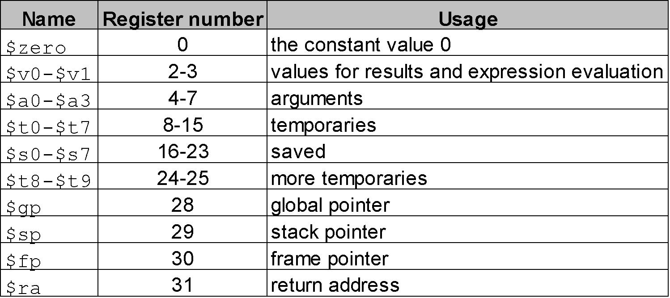
Policy-of-Use Convention for Registers
Register 1, called $at, is reserved for the assembler; registers 26-27,
called $k0 and $k1 are reserved for the operating system.
Notes:
‹#›

Slide 29
Assembly Language vs. Machine Language
Assembly provides convenient symbolic representation
much easier than writing down numbers
regular rules: e.g., destination first
Machine language is the underlying reality
e.g., destination is no longer first
Assembly can provide pseudo-instructions
e.g., move $t0, $t1 exists only in assembly
would be implemented using add $t0, $t1, $zero
When considering performance you should count actual number of machine instructions that will execute
Notes:
‹#›

Slide 30
Procedures
Example C code:
// procedure adds 10 to input parameter
int main()
{ int i, j;
i = 5;
j = add10(i);
i = j;
return 0;}
int add10(int i)
{ return (i + 10);}

Slide 31
Procedures
Translated MIPS assembly
Note more efficient use of registers possible!
.text
.globl main
main:
addi $s0, $0, 5
add $a0, $s0, $0
jal add10
add $s1, $v0, $0
add $s0, $s1, $0
li $v0, 10
syscall
save register
in stack, see
figure below
add10:
addi $sp, $sp, -4
sw $s0, 0($sp)
addi $s0, $a0, 10
add $v0, $s0, $0
lw $s0, 0($sp)
addi $sp, $sp, 4
jr $ra
argument
to callee
result
to caller
control returns here
jump and link
restore
values
return
system code
& call to
exit
MEMORY
High address
$sp
Content of $s0
Run this code with PCSpim: procCallsProg1.asm
Low address

Slide 32
MIPS: Software Conventions for Registers
0 zero constant 0
1 at reserved for assembler
2 v0 results from callee
3 v1 returned to caller
4 a0 arguments to callee
5 a1 from caller: caller saves
6 a2
7 a3
8 t0 temporary: caller saves
. . . (callee can clobber)
15 t7
16 s0 callee saves
. . . (caller can clobber)
23 s7
24 t8 temporary (cont’d)
25 t9
26 k0 reserved for OS kernel
27 k1
28 gp pointer to global area
29 sp stack pointer
30 fp frame pointer
ra return Address (HW):
caller saves

Slide 33
Procedures (recursive)
Example C code – recursive factorial subroutine:
int main()
{ int i;
i = 4;
j = fact(i);
return 0;}
int fact(int n)
{ if (n < 1) return (1);
else return ( n*fact(n-1) );}

Slide 34
Procedures (recursive)
Translated MIPS assembly:
.text
.globl main
main:
addi $a0, $0, 4
jal fact
nop
move $a0, $v0
li $v0, 1
syscall
li $v0, 10
syscall
fact:
addi $sp, $sp, -8
sw $ra, 4($sp)
sw $a0, 0($sp)
slti $t0, $a0, 1
beq $t0, $0, L1
nop
addi $v0, $0, 1
addi $sp, $sp, 8
jr $ra
L1:
addi $a0, $a0, -1
jal fact
nop
lw $a0, 0($sp)
lw $ra, 4($sp)
addi $sp, $sp, 8
mul $v0, $a0, $v0
jr $ra
branch to
L1 if n>=1
control
returns
from fact
return 1
if n < 1
print value
returned by
fact
if n>=1 call
fact recursively
with argument
n-1
exit
restore return
address, argument,
and stack pointer
save return
address and
argument in
stack
return
n*fact(n-1)
Run this code with PCSpim: factorialRecursive.asm
return control

Slide 35
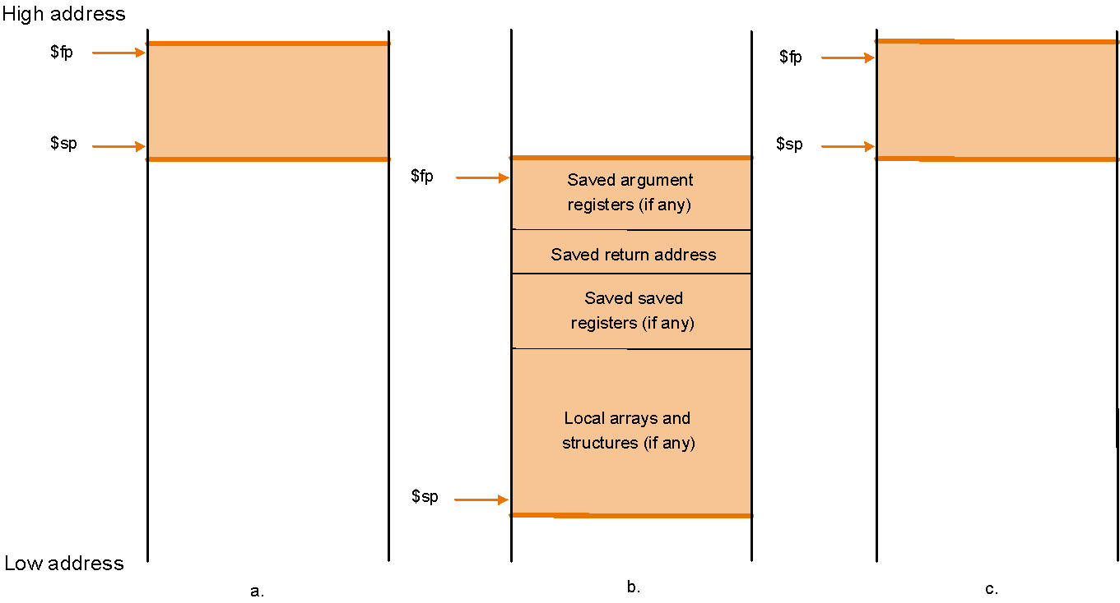
Using a Frame Pointer
Variables that are local to a procedure but do not fit into registers (e.g., local arrays, struc-
tures, etc.) are also stored in the stack. This area of the stack is the frame. The frame pointer
$fp points to the top of the frame and the stack pointer to the bottom. The frame pointer does
not change during procedure execution, unlike the stack pointer, so it is a stable base
register from which to compute offsets to local variables.
Use of the frame pointer is optional. If there are no local variables to store in the stack it is
not efficient to use a frame pointer.

Slide 36
Using a Frame Pointer
Example: procCallsProg1Modified.asm
This program shows code where it may be better to use $fp
Because the stack size is changing, the offset of variables stored in the stack w.r.t. the stack pointer $sp changes as well. However, the offset w.r.t. $fp would remain constant.
Why would this be better?
The compiler, when generating assembly, typically maintains a table of program variables and their locations. If these locations are offsets w.r.t $sp, then every entry must be updated every time the stack size changes!
Exercise:
Modify procCallsProg1Modified.asm to use a frame pointer
Observe that SPIM names register 30 as s8 rather than fp. Of course, you can use it as fp, but make sure to initialize it with the same value as sp, i.e., 7fffeffc.

Slide 37
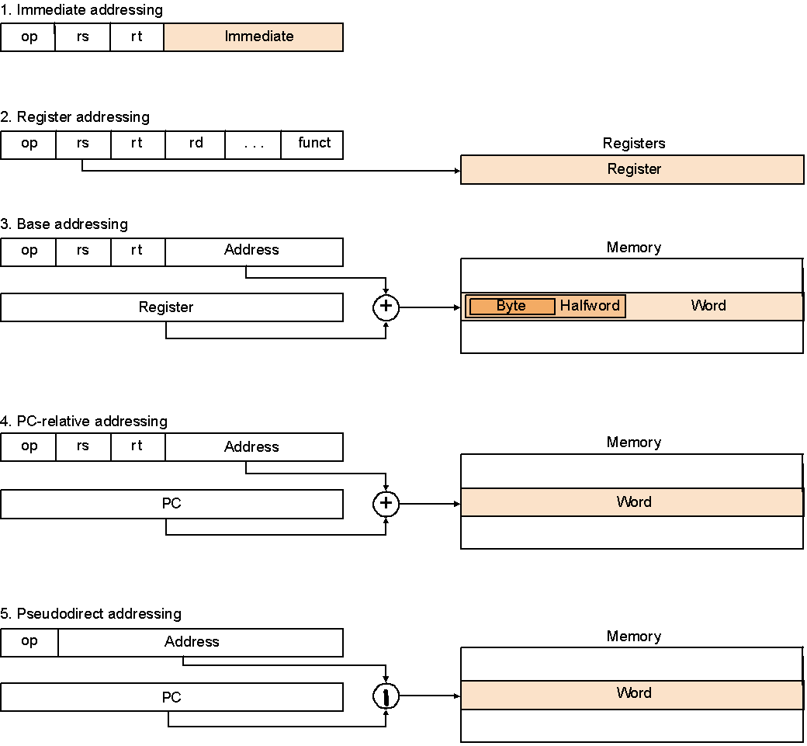
MIPS Addressing Modes

Slide 38
Overview of MIPS
Simple instructions – all 32 bits wide
Very structured – no unnecessary baggage
Only three instruction formats
Rely on compiler to achieve performance
what are the compiler's goals?
Help compiler where we can
op rs rt rd shamt funct
R
I
op rs rt 16 bit address
op 26 bit address
J
Notes:
‹#›

Slide 39
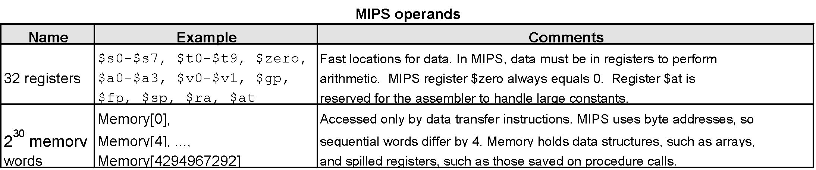
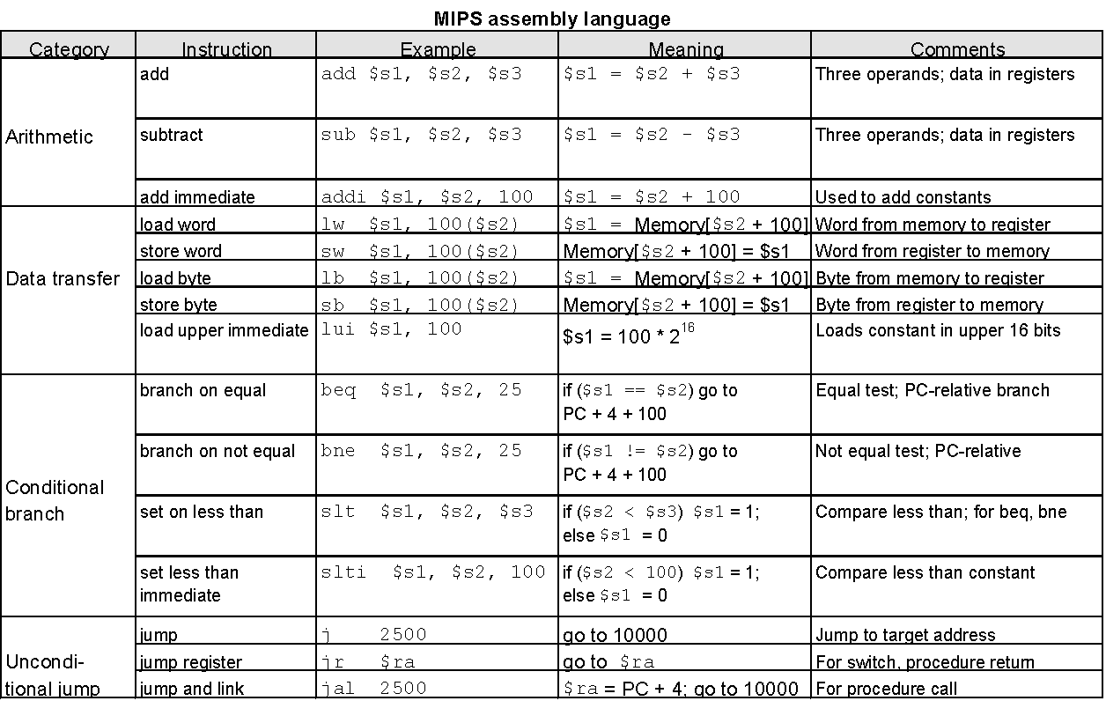
Summarize MIPS:
Notes:
‹#›

Slide 40
Alternative Architectures
Design alternative:
provide more powerful operations
goal is to reduce number of instructions executed
danger is a slower cycle time and/or a higher CPI
Sometimes referred to as R(educed)ISC vs. C(omplex)ISC
virtually all new instruction sets since 1982 have been RISC
We’ll look at PowerPC and 80x86
Notes:
‹#›

Slide 41
PowerPC Special Instructions
Indexed addressing
Example: lw $t1,$a0+$s3 #$t1=Memory[$a0+$s3]
what do we have to do in MIPS? add $t0, $a0, $s3
lw $t1, 0($t0)
Update addressing
update a register as part of load (for marching through arrays)
Example: lwu $t0,4($s3) #$t0=Memory[$s3+4];$s3=$s3+4
what do we have to do in MIPS? lw $t0, 4($s3)
addi $s3, $s3, 4
Others:
load multiple words/store multiple words
a special counter register to improve loop performance:
bc Loop, ctrl != 0 # decrement counter, if not 0 goto loop
MIPS: addi $t0, $t0, -1
bne $t0, $zero, Loop
Notes:
‹#›

Slide 42
A dominant architecture: 80x86
1978: The Intel 8086 is announced (16 bit architecture)
1980: The 8087 floating point coprocessor is added
1982: The 80286 increases address space to 24 bits, +instructions
1985: The 80386 extends to 32 bits, new addressing modes
1989-1995: The 80486, Pentium, Pentium Pro add a few instructions (mostly designed for higher performance)
1997: MMX is added “this history illustrates the impact of the “golden handcuffs” of compatibility”
“adding new features as someone might add clothing to a packed bag”
Notes:
‹#›

Slide 43
A dominant architecture: 80x86
Complexity
instructions from 1 to 17 bytes long
one operand must act as both a source and destination
one operand may come from memory
several complex addressing modes
Saving grace:
the most frequently used instructions are not too difficult to build
compilers avoid the portions of the architecture that are slow
“an architecture that is difficult to explain and impossible to love”
“ what the 80x86 lacks in style is made up in quantity, making it beautiful from the right perspective”
Notes:
‹#›

Slide 44
Summary
Instruction complexity is only one variable
lower instruction count vs. higher CPI / lower clock rate
Design Principles:
simplicity favors regularity
smaller is faster
good design demands compromise
make the common case fast
Instruction set architecture
a very important abstraction indeed!
Notes:
‹#›

